Slide 1
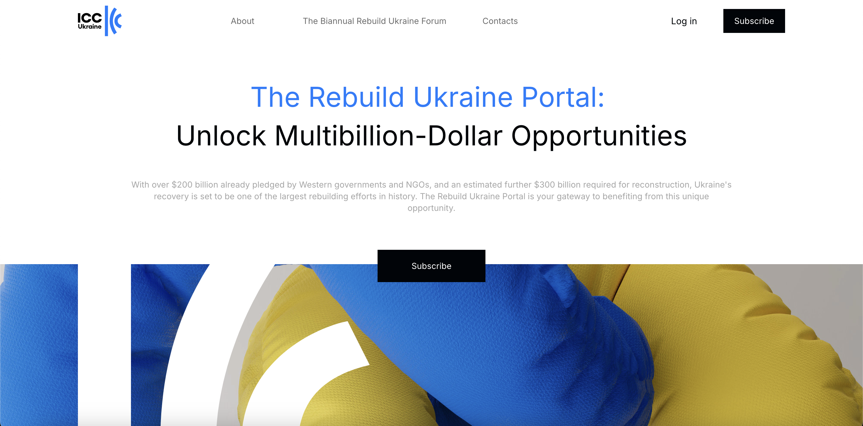
The ICC Rebuild Ukraine Portal

Slide 2
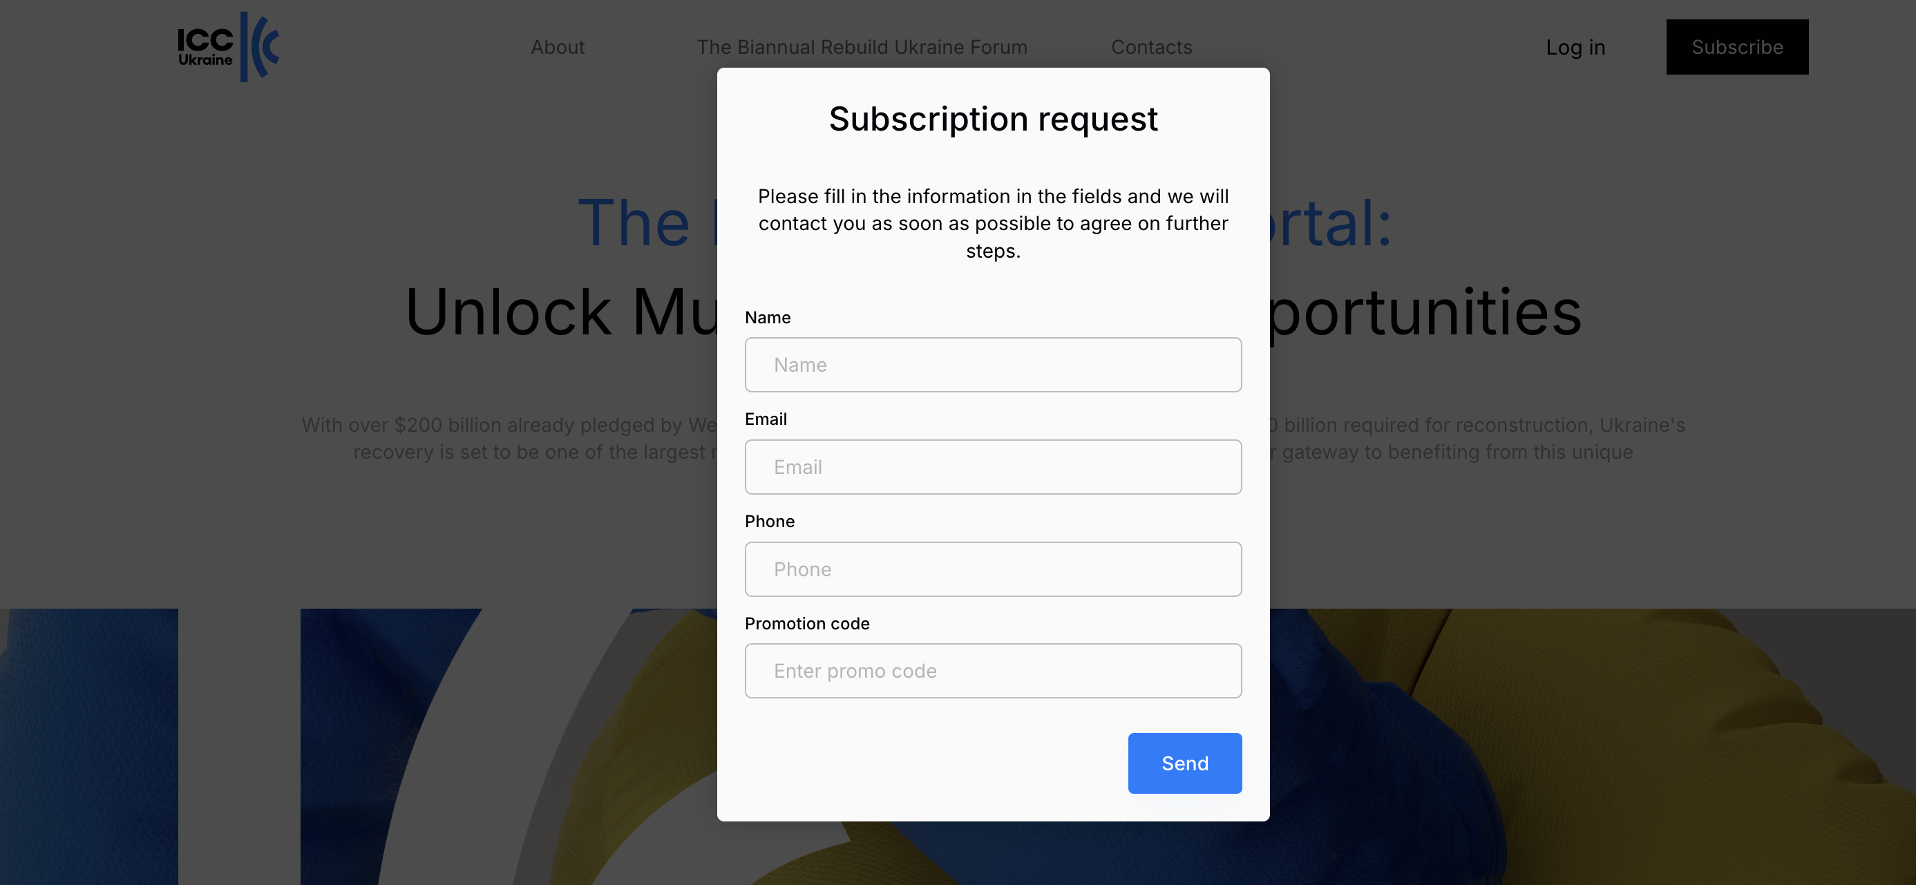
The ICC Rebuild Ukraine Portal

Slide 3
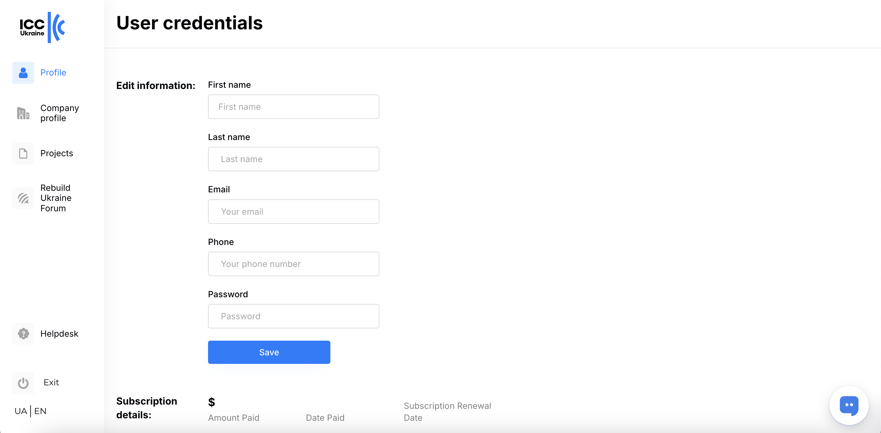
The ICC Rebuild Ukraine Portal

Slide 4
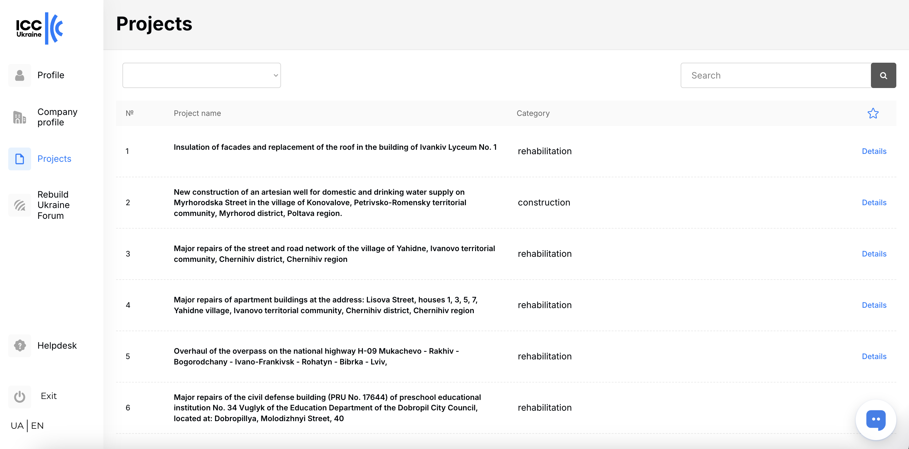
The ICC Rebuild Ukraine Portal

Slide 5
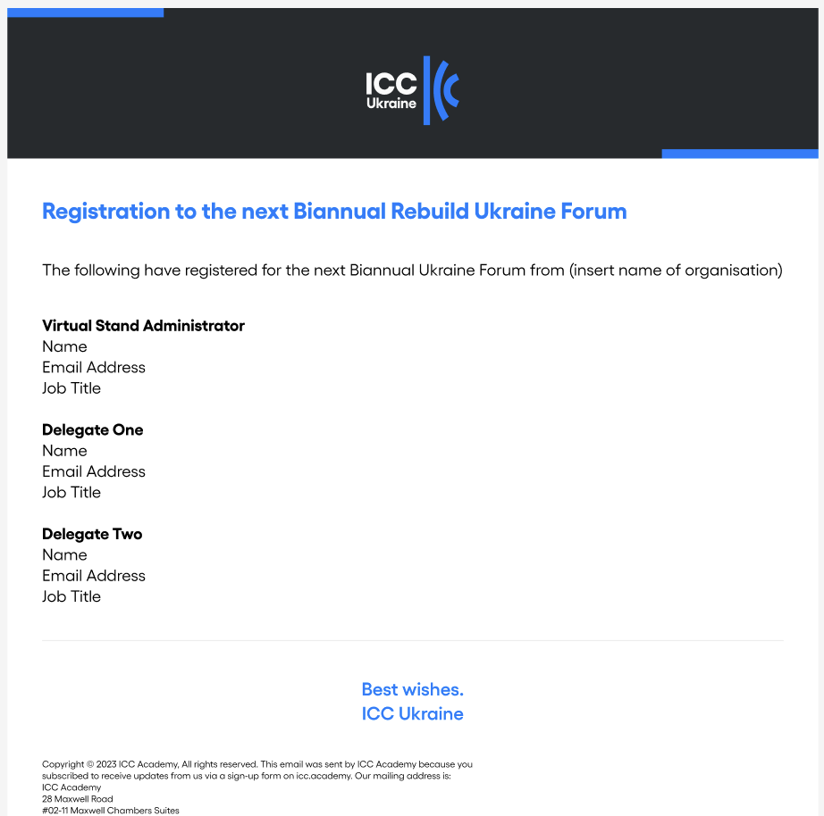
The ICC Rebuild Ukraine Portal

Slide 6
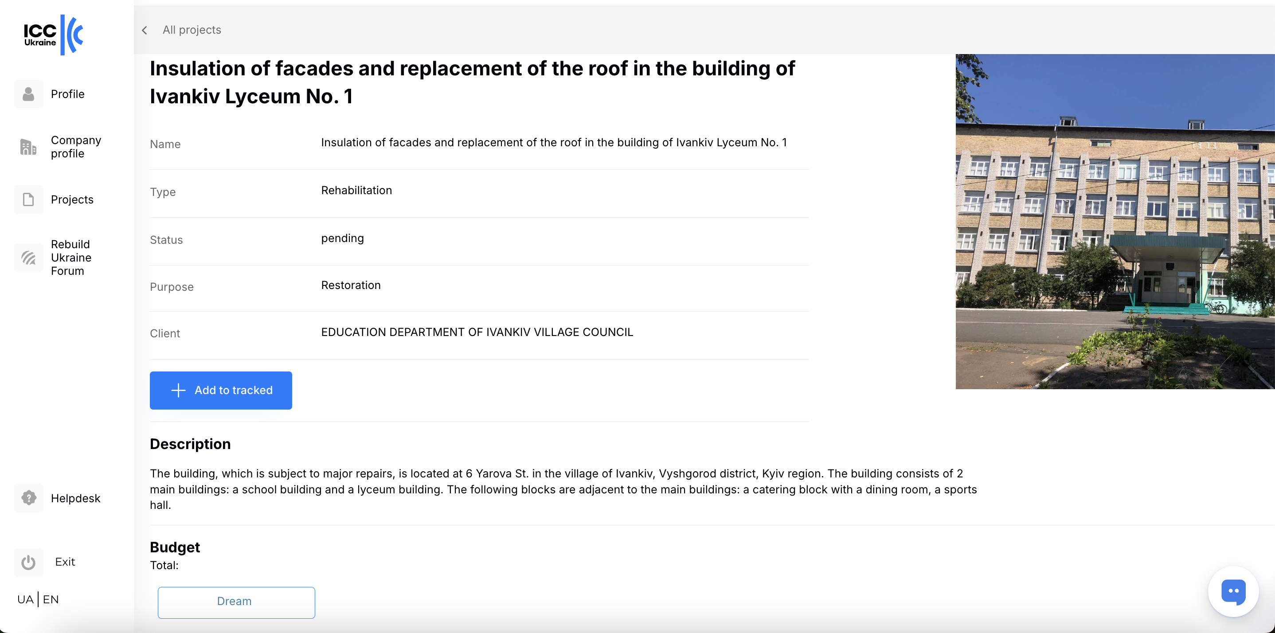
The ICC Rebuild Ukraine Portal

Slide 7
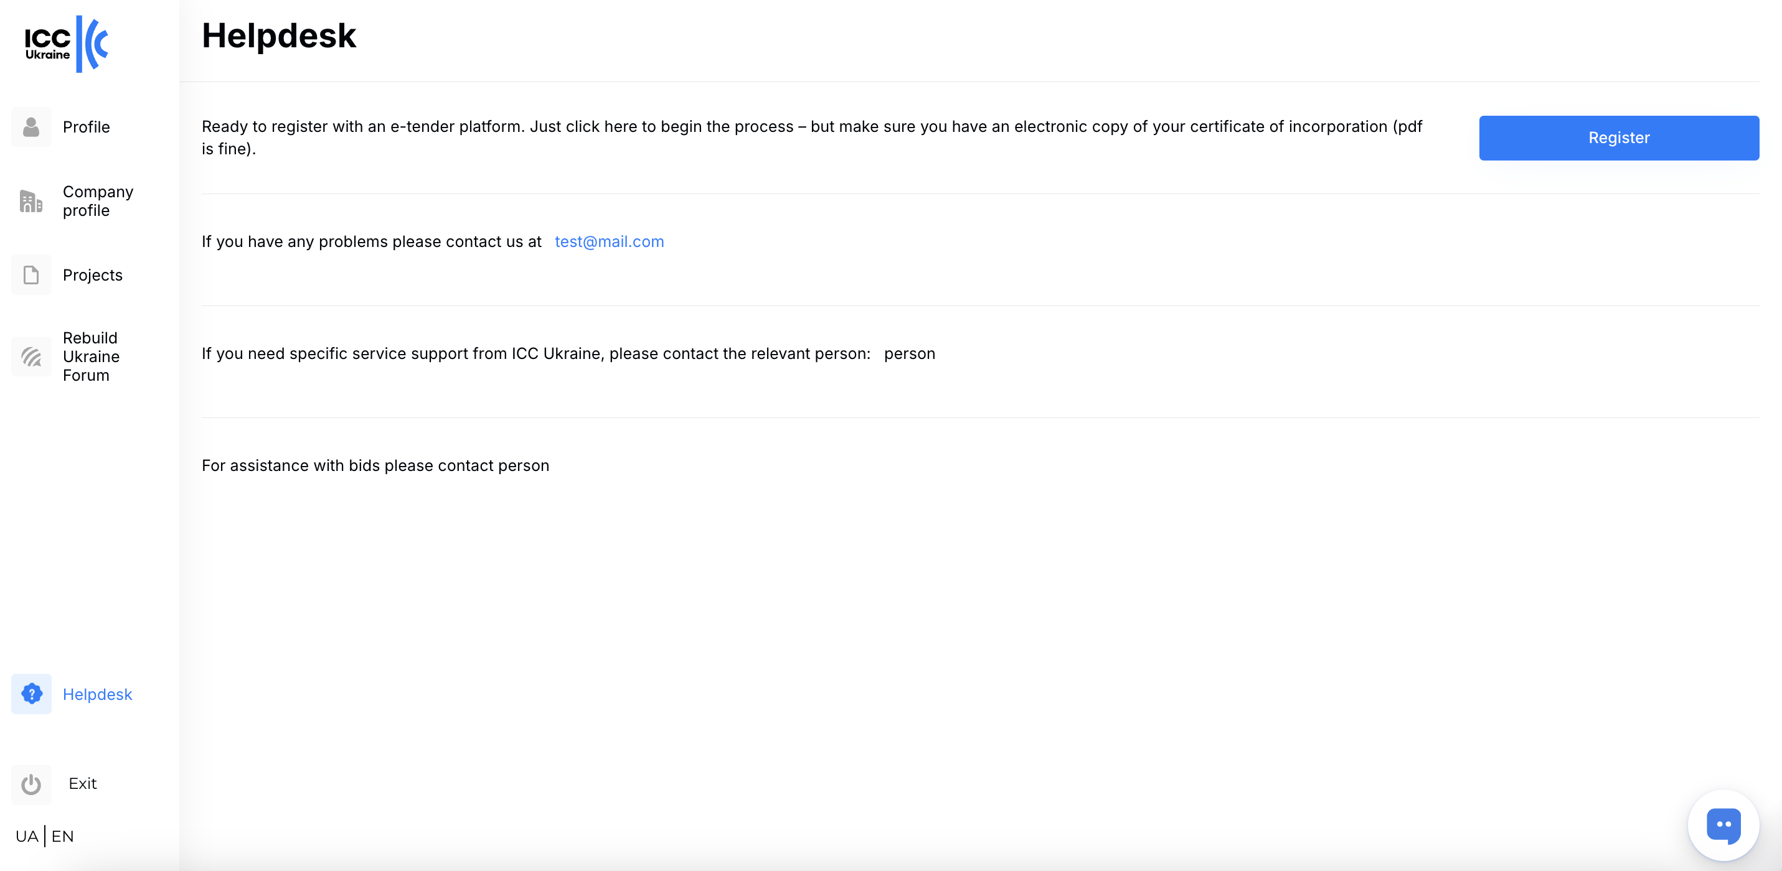
The ICC Rebuild Ukraine Portal

Slide 8
The ICC Rebuild Ukraine Portal

Slide 9
The ICC Rebuild Ukraine Portal
The Benefits:
A single interface into three platforms.
Early warning of upcoming projects.
An easier, automated project tracking system.
Automated translation of Ukrainian text into English.

Slide 10
The ICC Rebuild Ukraine Portal
Annual Subscription includes:
Unlimited access to the Portal
Free Virtual Stand at 2 Biannual Rebuild Ukraine online events.
Two Corporate Delegate Tickets to 2 Biannual Rebuild Ukraine online events
The annual subscription costs just USD 2,500 (plus VAT if applicable)
Go to: https://rebuild.iccua.org – use the coupon OFMS1WQW for 50% off – but hurry this coupon will expire on Saturday, 22nf March.

