Slide 1
Construction & Infrastructure
A Macro Overview of the Industry
Number of companies: >10,000
Number of employees: >100,000s
Import statistics: Construction materials, machinery, and equipment for infrastructure reconstruction continue to grow, indicating strong demand for foreign products.

Slide 2
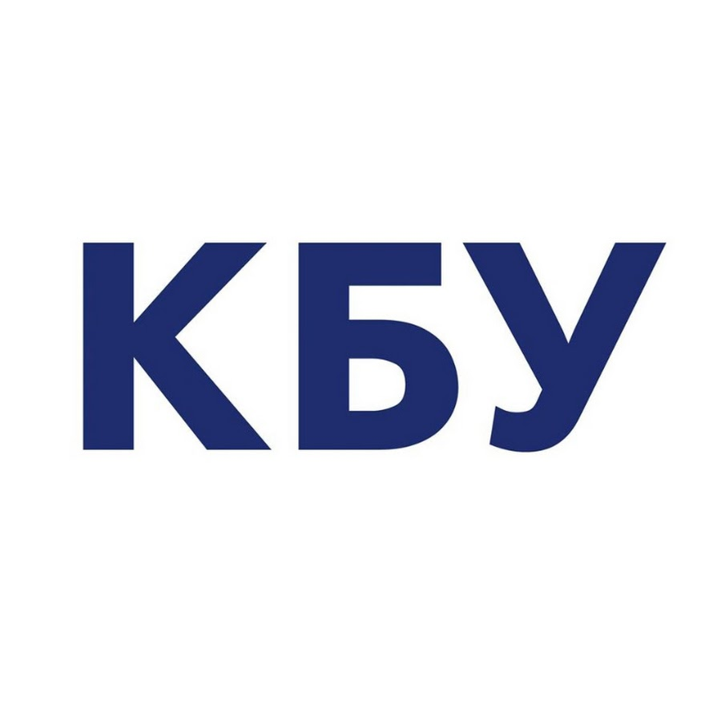
Key Industry Associations
Construction Chamber of Ukraine
Confederation of Builders of Ukraine
Ukrainian Water Association
Ukrcement Association
National Union of Architects of Ukraine (UUA)
Ukrainian Construction Association (UCA)
Ukrainian Association of Water Supply and Sewerage Enterprises
All-Ukrainian Association of Construction Industry Enterprises
Guild of Builders of Ukraine Association
Association of Builders of Ukraine
Union of Manufacturers of Building Materials of Ukraine

Slide 3
Rebuild Program Participation
How are the industry players currently active in the Rebuild Program?
13 percent of Ukraine’s total housing stock has been damaged or destroyed, affecting more than 2.5 million households. The housing sector alone accounts for about $84bn of the total long-term need. Plus:
The Rebuild Ukraine Program provides funding for large and small projects, including the reconstruction of roads, bridges, water supply networks, and energy facilities.
Construction companies are actively involved in the implementation of projects, contributing to the rapid restoration of damaged infrastructure.
Local governments, as well as large corporations and international partners, are actively cooperating to secure funding and ensure the effective implementation of projects.

Slide 4
Foreign Company Participation
How are foreign companies currently active in the Rebuild Program? How do they complement the services and capacity of Ukrainian companies?
Foreign companies play an important role in the infrastructure recovery programme by providing additional resources, expertise and technology.
They can work independently or as part of consortia with Ukrainian companies.
Foreign firms complement Ukrainian companies by providing high-end technology, technical support, and the latest construction materials and equipment.

Slide 5
Company Matchmaking
ICC and trade associations can organise platforms for meeting between Ukrainian and foreign companies.
They can provide information about cooperation opportunities and help organise meetings and negotiations.
These organisations can also coordinate cooperation processes and support joint initiatives to make Rebuild projects more efficient.

Slide 6
Summary & Conclusions
There is significant demand for construction and infrastructure repair in Ukraine.
There is a shortage of capacity in the industry to satisfy demand.
Significant finance from the Rebuild Ukraine Program is available.
There is room for foreign companies; either working independently or in consortia.
Therefore:
There are significant opportunities for foreign companies to participate.
Working with local partners is a good way for foreign companies to enter the market.
ICC can help foreign companies find reliable partners among Ukrainian enterprises.

